Slide 1

Data Dictionary
(Chapter 05)
MIS 372 Spring 2022

Slide 2

Do Check-in First
https://forms.office.com/r/nwsEdTduTE

Slide 3
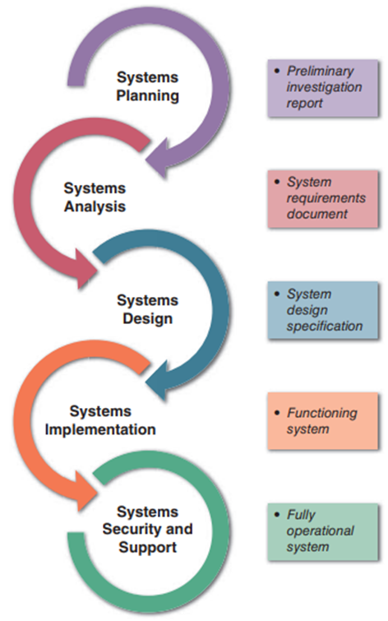
Where We Are in SDLC

Slide 4
Learning Objectives
1. Need for Understanding the Data Dictionary
2. Building Blocks of Data Dictionary
3. Creating Data Dictionary
4. Using Data Dictionary

Slide 5
1. Need for Understanding the Data Dictionary
Provide documentation
Eliminate redundancy
Validate the data flow diagram
Provide a starting point for developing screens and reports
Determine the contents of data stored in files
To develop the logic for DFD processes
Create XML

Slide 6
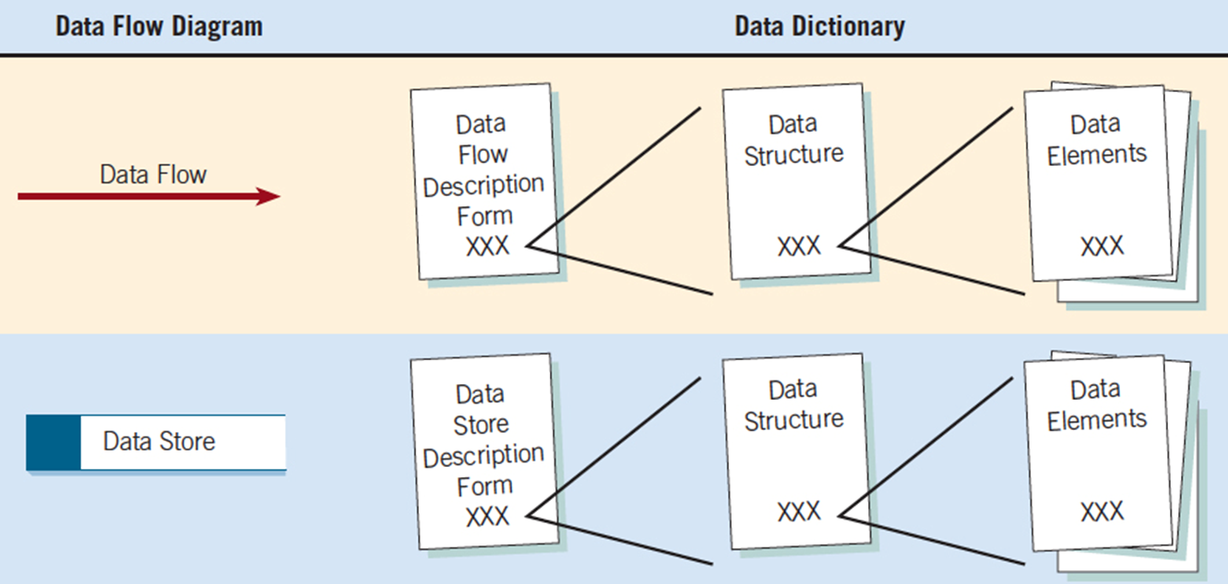
2. Key Building Blocks of a Data Dictionary
From DFD to Data Dictionary
Each data store and data flow should be defined and then expanded to include the details of the elements it contains.

Slide 7
Data Dictionary Categories
The following four data dictionary categories should be developed to promote understanding of the data in the system.
Data Dictionary
Data Flows
Data Structures
Elements
Data Stores

Slide 8
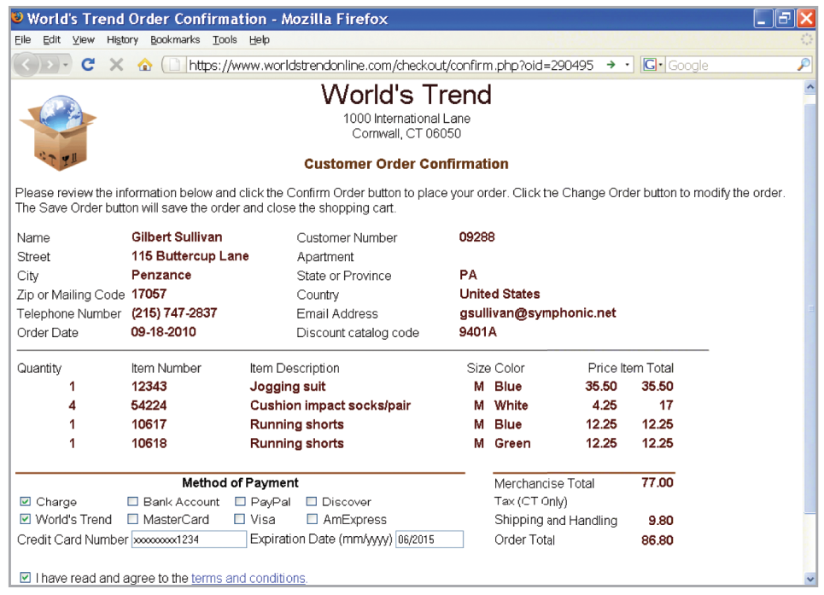
Example – An online order

Slide 9
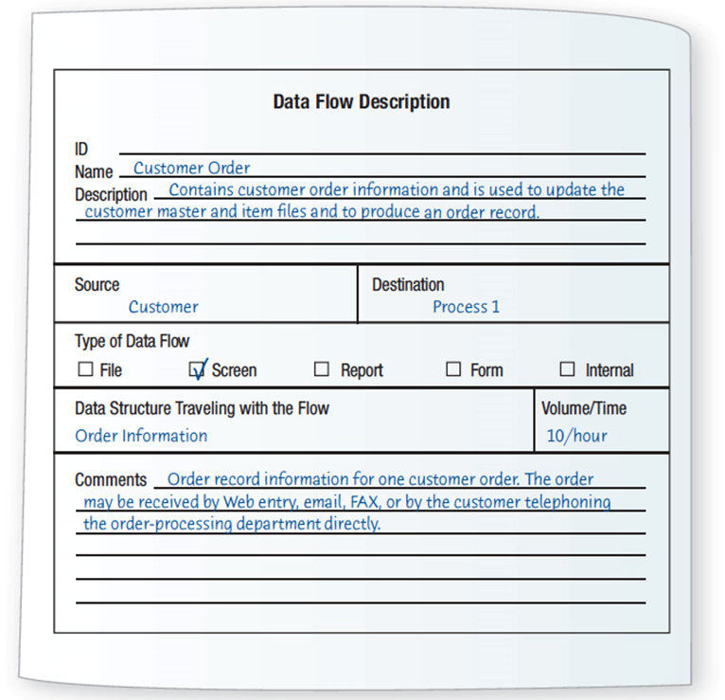
2.1 Defining the Data Flow
ID — identification number
Unique descriptive name
A general description of the data flow
The source of the data flow
The destination of the data flow
Type of data flow
The name of the data structure describing the elements
The volume per unit time
An area for further comments and notations

Slide 10
2.2 Describing Data Structures
Data structures describe the detailed data variables (or fields).
An algebraic notation is used to describe data structures
Equal sign (=) means “is composed of”
Plus (+) sign means “and”
Braces {} mean repetitive elements
Brackets [] for an either/or situation
Parentheses () for an optional element

Slide 11
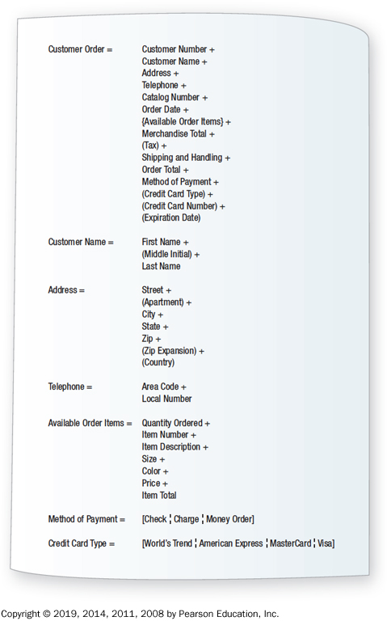
Data Structure Example for Adding a Customer Order

Slide 12
Structural Records
A structure may consist of elements or structural records
These are a group of elements, such as:
Customer name, Address, Telephone
Each of these must be further defined until they are broken down into their component elements
Structural records and elements that are used within many different systems are given a non-system-specific name, such as street, city, and zip

Slide 13
2.3 Logical and Physical Data Structures
Stage 1: Logical
Show what data the business needs for its day-to-day operations
Stage 2: Physical
Include additional elements necessary for implementing the system
Physical Data Structure
Key fields used to locate records
Codes to identify record status
Transaction codes to identify different record types
Repeating group entries
Limits on items in a repeating group
Password

Slide 14
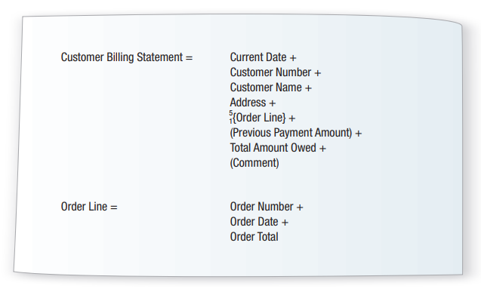
Example of Physical Data Structures

Slide 15
2.4 Data Elements
Each data element is defined in the data dictionary.
This part directly relates to the database schema design, therefore, there are many details.

Slide 16
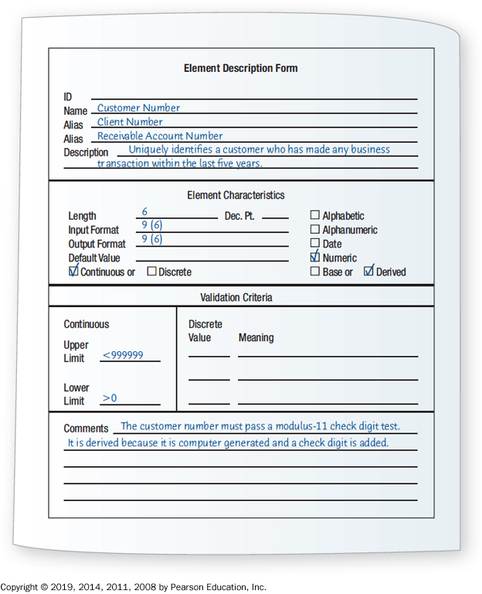
Key building blocks
Element I D
The name of the element
Aliases
A short description of the element
Element is base or derived
Element length
Type of data
Input and output formats
Validation criteria
Default value
An additional comment or remark area

Slide 17
Principles in Drafting Data Elements Description
The name of the element should be descriptive and unique
Based on what the element is commonly called in most programs or by the major user of the element
All aliases (synonyms or other names for the element in other processes) must be included.
A customer number may also be called a receivable account number or a client number
A base element is one that has been initially keyed into the system
A derived element is one that is created by a process, usually as the result of a calculation or a series of decision-making statements

Slide 18
Principles in Drafting Data Elements Description (cont.)
What should the element length be?
The analyst must decide how truncated data will affect the system outputs
Fun Facts on the Length of an Element
Element | Length | Percent of Data That Will Fit (United States)
Last Name | 11 | 98
First Name | 18 | 95
Company Name | 20 | 95
Street | 18 | 90
City | 17 | 99

Slide 19
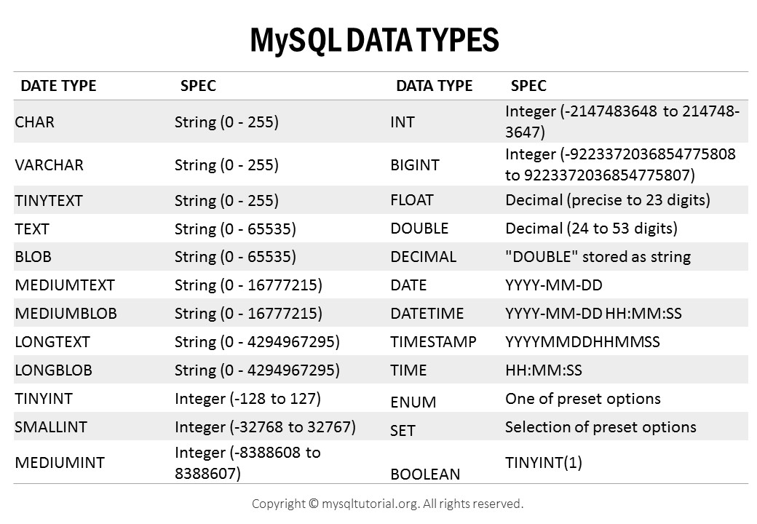
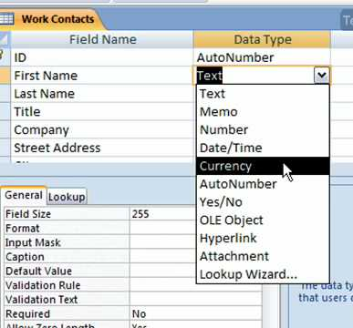
Principles in Drafting Data Elements Description (cont.)
Appropriate data type for each data element should be determined.
Comparisons between MySQL vs. MS Access Data Types
Microsoft Access Data Types

Slide 20
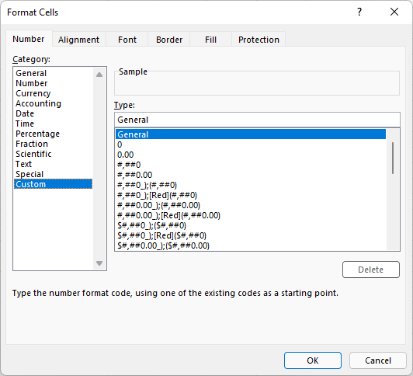
Principles in Drafting Data Elements Description (cont.)
Special coding symbols are used to indicate how the data format is look like in input and output.
Formatting Character | Meaning
X | May enter or display/print any character
9 | Enter or display only numbers
Z | Display leading zeros as spaces
, | Insert commas into a numeric display
. | Insert a period into a numeric display
/ | Insert slashes into a numeric display
- | Insert a hyphen into a numeric display
V | Indicate a decimal position (when the decimal point is not included)
Relatable example from Excel

Slide 21
Principles in Drafting Data Elements Description (cont.)
Validation criteria should be implemented to prevent wrong entry. (discrete or continuous)
Include any default value the element may have
Additional comment or remarks area can be created to include instructions etc.

Slide 22
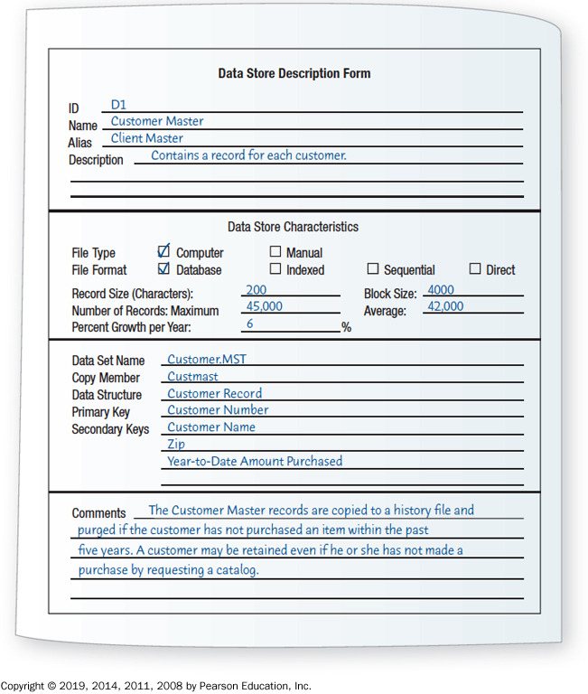
2.4 Data Store
When data flow base elements are grouped together to form a structural record, a data store is created for each unique structural record.
Because a given data flow may only show part of the collective data that a structural record contains, many different data flow structures may need to be examined to arrive at a complete data store description.

Slide 23
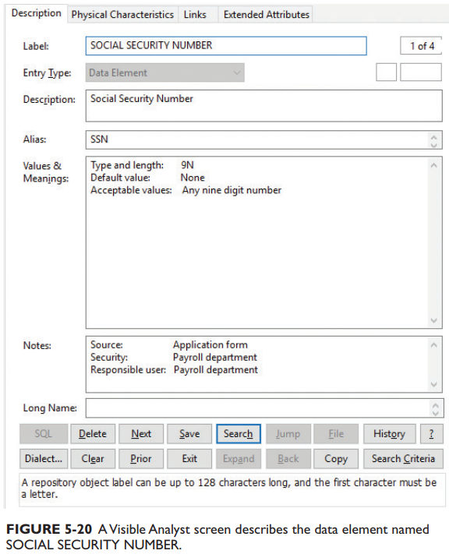
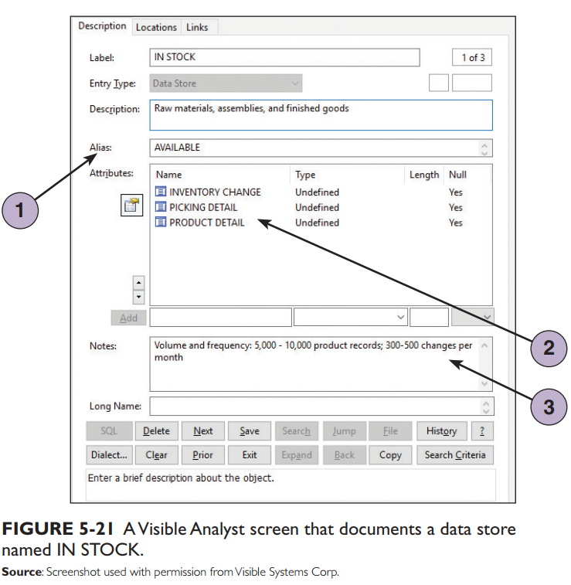
Data Dictionary in Visible Analyst

Slide 24
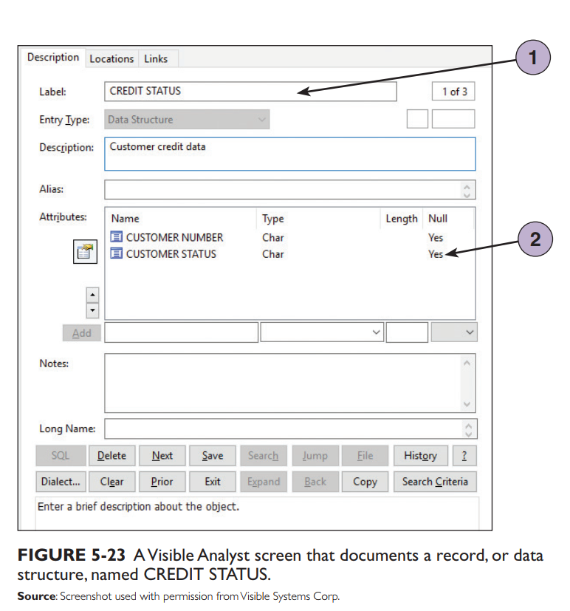
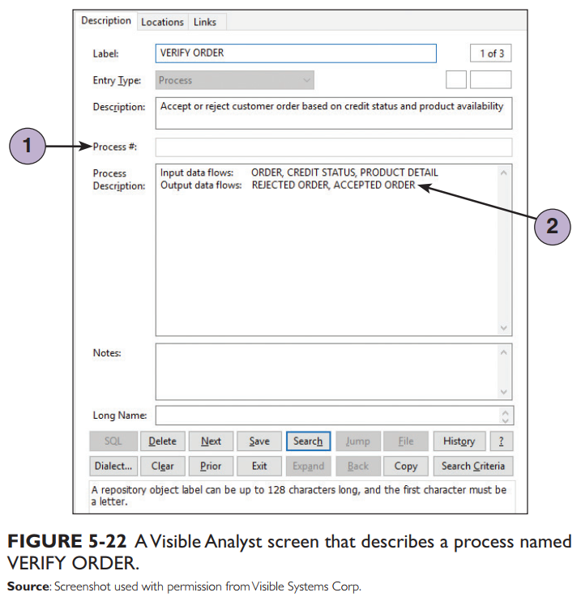
Data Dictionary in Visible Analyst (cont.)

Slide 25
3. Creating a Data Dictionary
Data dictionary entries are
Created after the data flow diagram is completed, or
Created as the data flow diagram is being developed

Slide 26
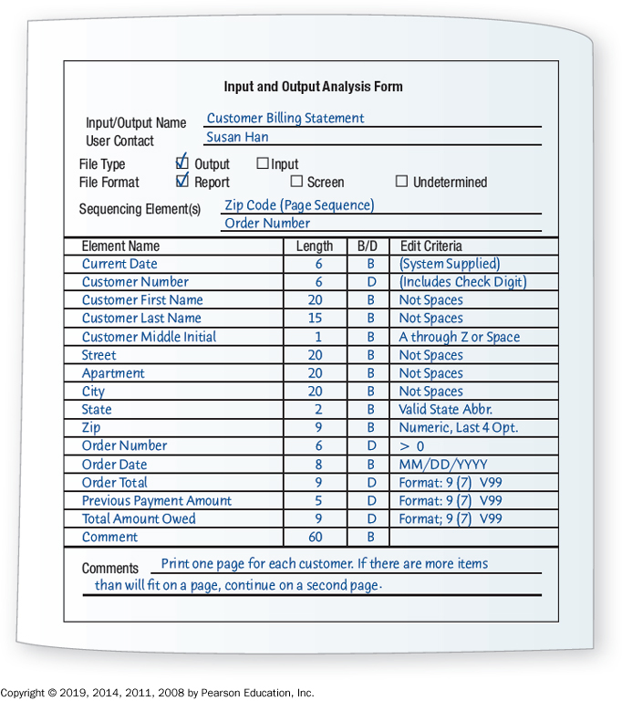
Analyzing Input and Output
A descriptive name for the input or output
The user contact responsible
Whether the data is input or output
The format of the data flow
Elements indicating the sequence of the data on a report or screen
A list of elements

Slide 27
4. Using a Data Dictionary
May be used to
Create screens, reports, and forms
Generate computer language source code
Analyze the system design, detecting flaws and areas that need clarification

